Slide 1
Micro Frontends

Slide 2
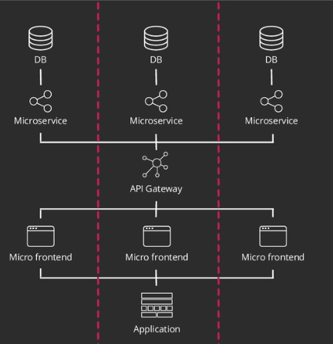
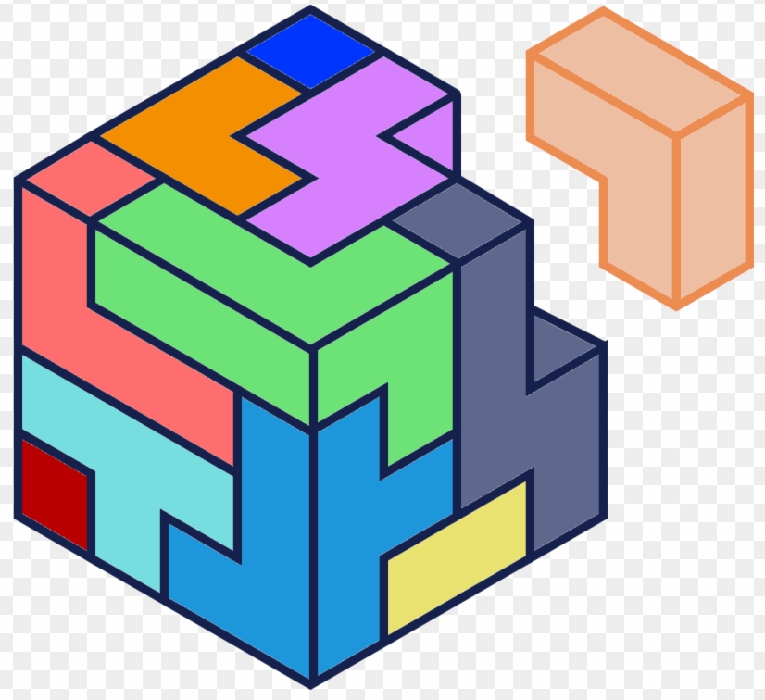
Micro Frontends

Slide 3
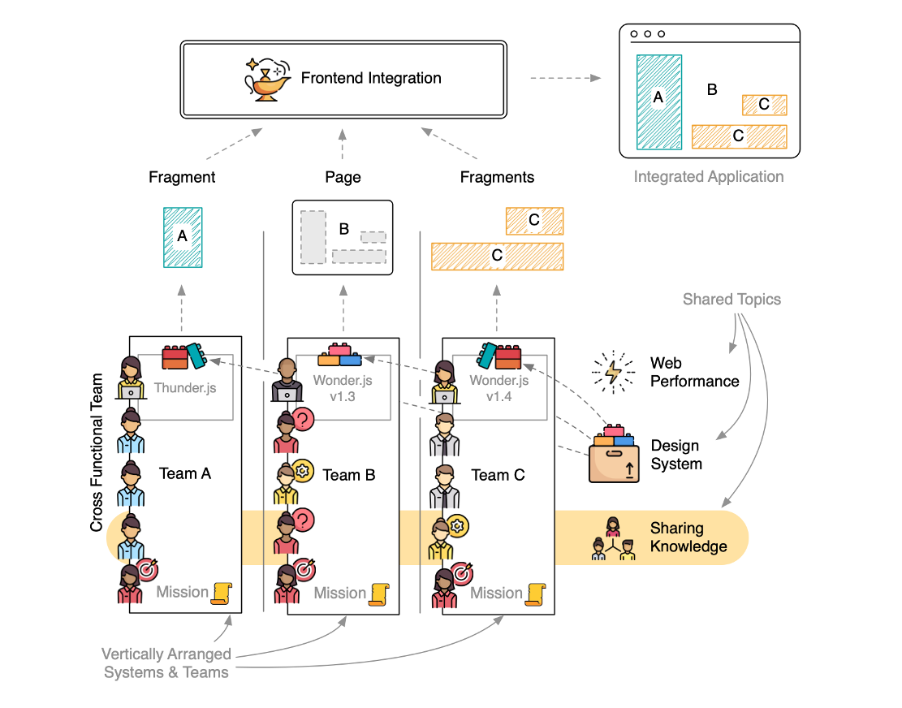
Micro Frontends | The Big Picture
“The idea behind Micro Frontends is to think about a website or web app as a composition of features which are owned by independent teams. Each team has a distinct area of business or mission it cares about and specializes in. A team is cross functional and develops its features end-to-end, from database to user interface” – www.micro-frontends.org

Slide 4
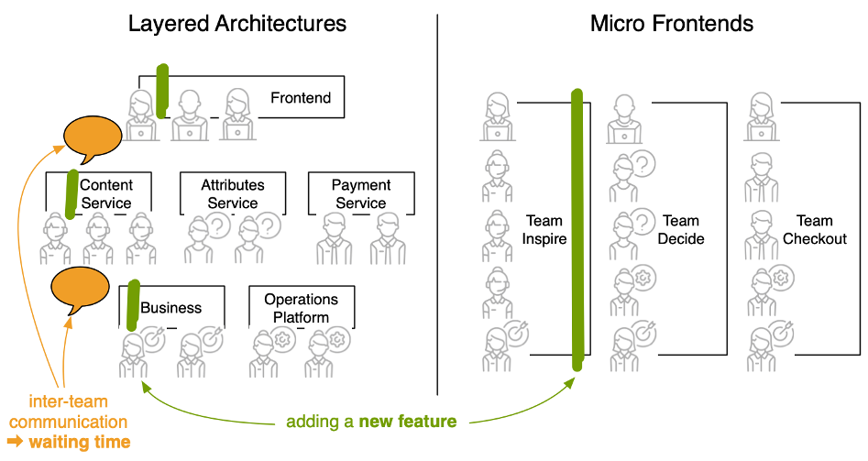
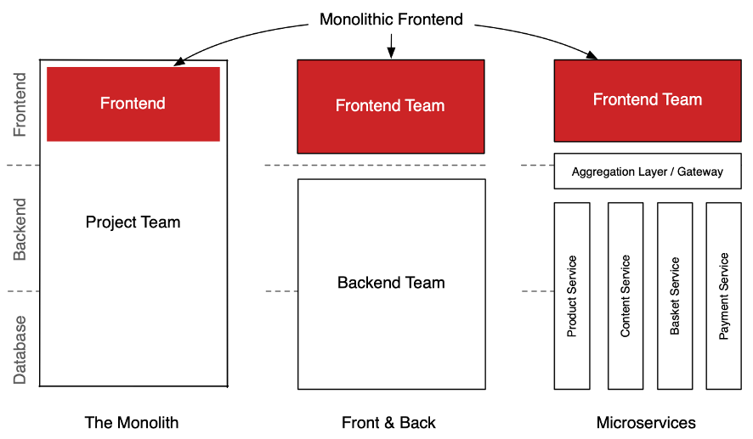
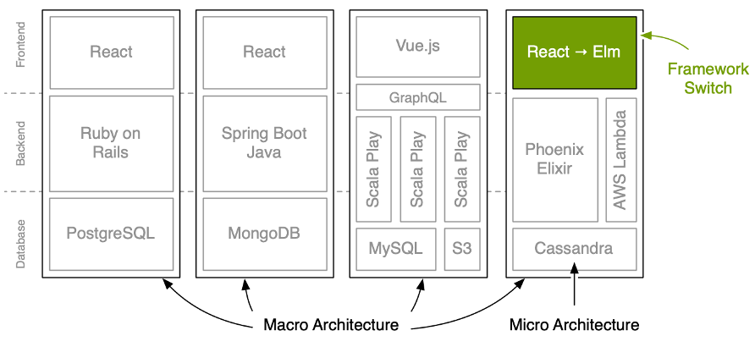
Micro Frontends | Why
OPTIMIZED FOR
FEATURE DEVELOPMENT
NO FRONT END MONOLITH
ABLE TO CHANGE CONTINUALLY
MFE –Each team builds and manages its feature e2e so no layered communication wastage
Scaling the Front End
Isolated Risk to Failure
Easier to understand & Refactor
No huge Investment & multi year Migrations
Localized Decision making - MicroArchitecture

Slide 5
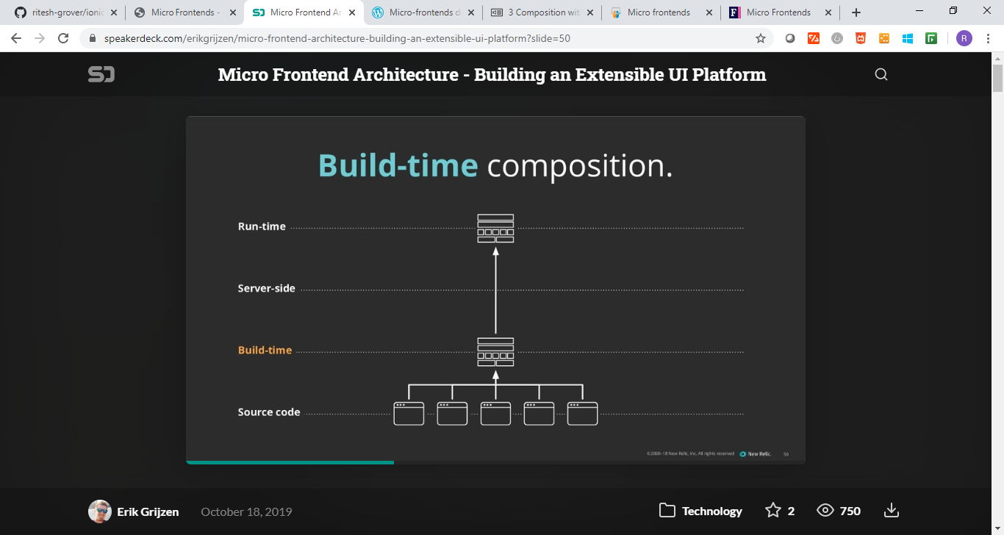
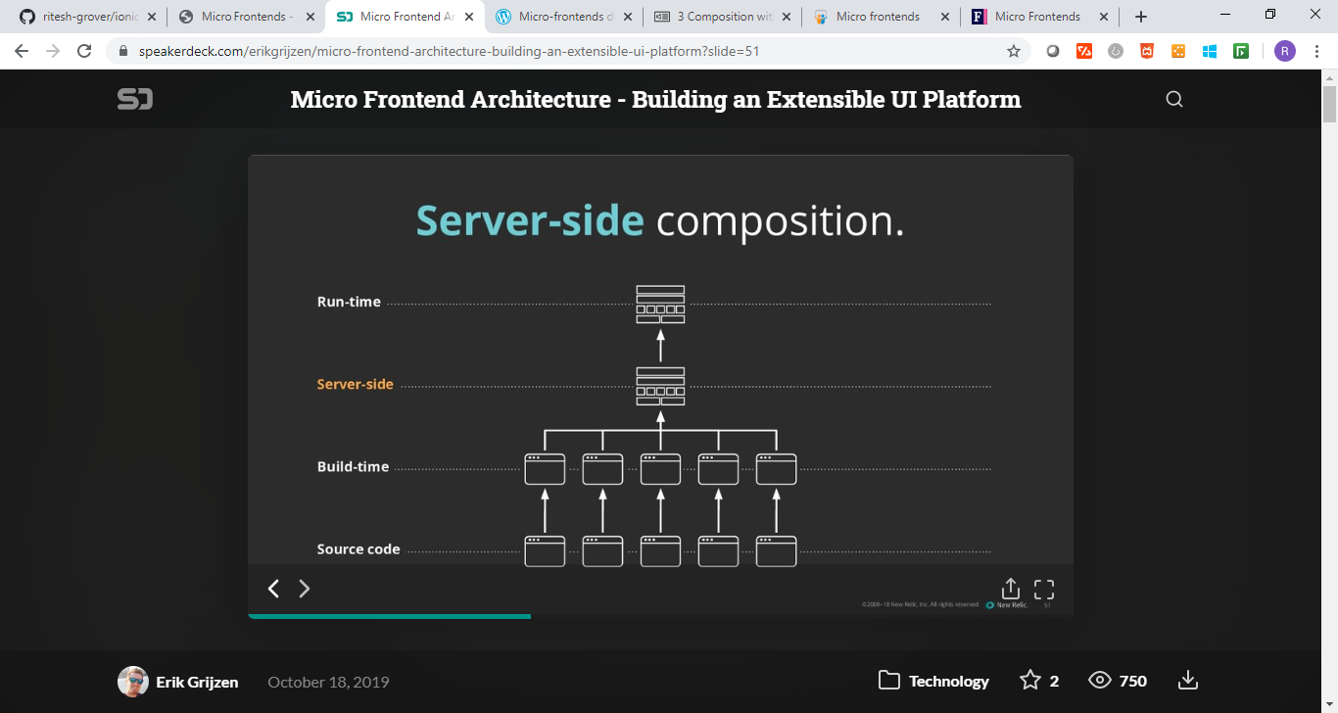
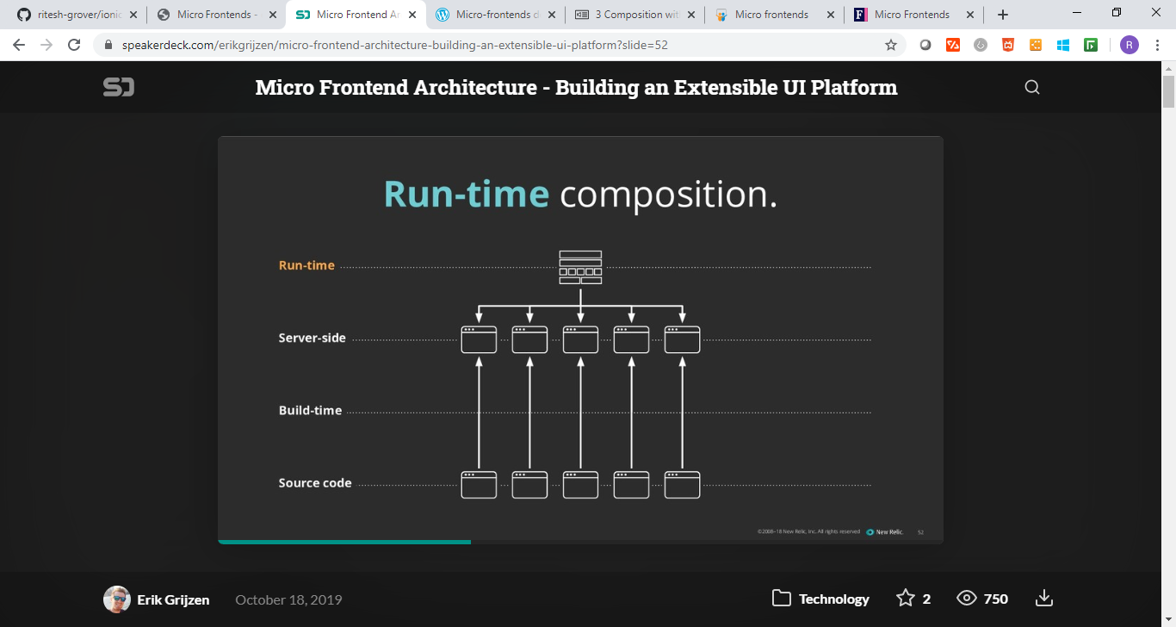
Micro Frontends | Composition Approach
BUILD TIME COMPOSITION
SERVER SIDE COMPOSITION
RUN TIME COMPOSITION
Client Side
Server -Side
Build Time
Source Code

Slide 6
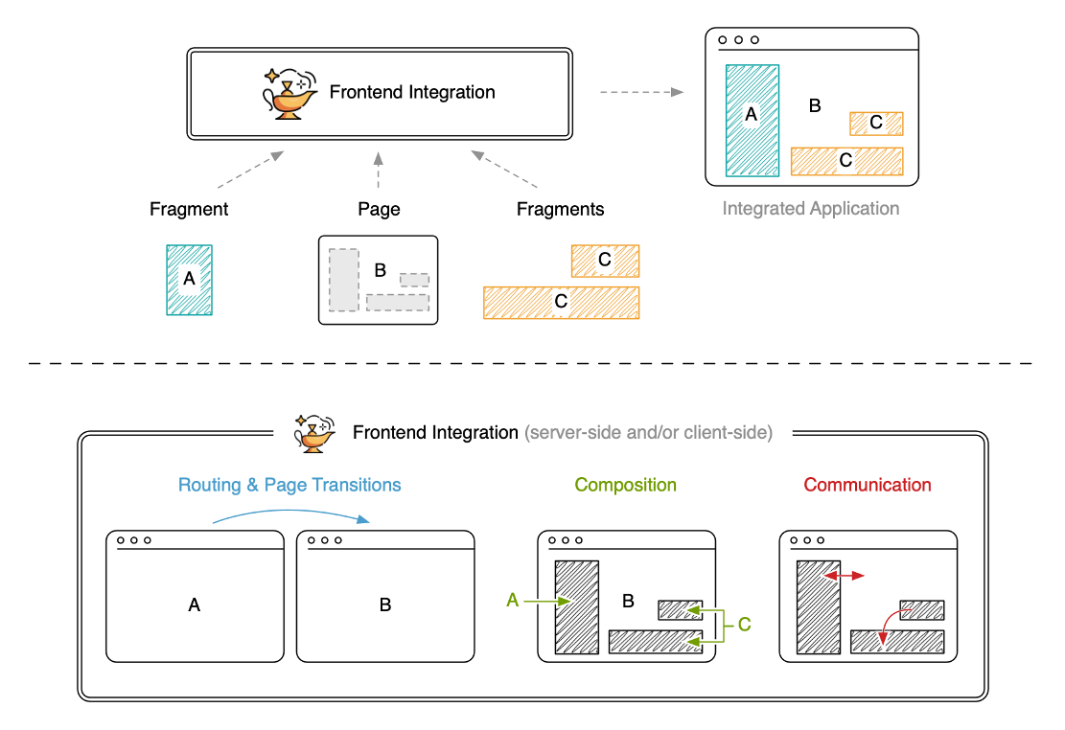
Micro Frontends | Run Time Composition
Primary Page App (L1)
Page Controls App- ToolBox
Header (MFE)
Mega-Menu (MFE)
L2: Primary Page App – Stitching Layer
MFE
MFE
MFE
MFE
Footer App (MFE)

Slide 7

Micro Frontends | Pros and Cons
PROS
CONS
Maintenance: Faster time to market, less bugs and less downtime through releasing smaller batches
High Initial Costs: This type of architecture requires more initial analysis to understand how everything will work in integration, and how the application can be broken into smaller modules
Technologies: Teams can work in different front-end technologies without conflicting with each other. Adoption and implementation with newer technologies at a lower risk
Consistency: Allowing multiple technologies and isolation increases the risk of lack of consistency. A plan should be in place to mitigate this. An example is the use of a style guide and a set of standard tools to help drive the development toward a similar direction
Deployment: Releasing micro-services become smooth by delivering small pieces of the application separately at any time without affecting others
Complexity: Building micro-services introduces significant architectural complexity which will require deeper analysis and quicker interactions
UX consistency and rich UI are harder to achieve
Page Load Time will increase
This approach can get quite complex if there are a large number of significantly different clients implemented using different technologies (e.g. web, native mobile clients, desktop, etc.)
Economies of Scale: Complexity of the whole system logarithmically rises with the number of teams (bigger hit in the beginning, but then scaling quite well with increase in the number of teams)

Slide 8






Micro Frontends | Challenges and Learnings
Below are some of the key challenges that we have faced while carrying out similar UI modernization engagements for our clients. The learnings from these engagements can be leveraged and the challenges addressed for a successful micro front-end implementation.
SEO RANKING
UX DESIGN
Challenges in SEO indexing for the pages called inside the IFRAME (the pages are customer facing and conversion rates are one of the key factors, and SEO plays an important role in the same)
Unable to achieve Responsive Web Design implementation to support the web app on multiple devices
Unable to achieve cross-browser support for the web app
Unable to develop interactive web pages that are in alignment with the UX design
SERVER SIDE RENDERING
BUILD AND DEPLOYMENT
Unable to arrive at an optimal design approach for server side rendering
Unable to arrive at a common build and deployment process for the different technologies in the stack (i.e. Angular, React, etc.)
CODE MAINTAINABILITY
PERFORMANCE
Unable to achieve the performance benchmark for loading / response time of a page due to different technologies in the stack
Challenges in maintaining multiple code bases

Slide 9
Thank you
Ritesh Grover

